Slide 1
Kernel PCA
Bhuvaneshawari Patil

Slide 2
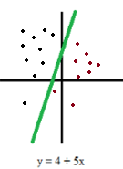
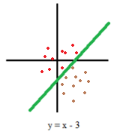
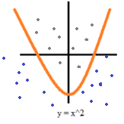
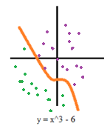
Linear vs. Non-linear data set / models
Model has linear relation with the parameters
Example:
Linear regression, KNN, SVM, K-means, etc.
Transformation of data to a new representational space (based on the kernel function) required
Example:
MLP, ANN, KPCA, nonlinear SVM, etc.

Slide 3


PCA algorithm steps
Standardization of the data
Computing the covariance matrix
Calculating the eigenvectors and eigenvalues
Computing the Principal Components
Reducing the dimensions of the data set

Slide 4
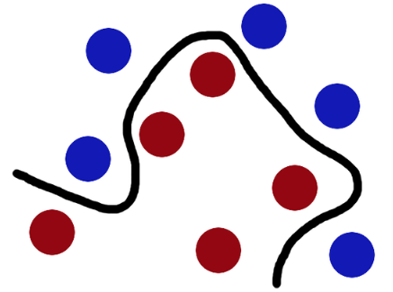


Kernel functions
A “kernel” is usually used to refer to the kernel trick, a method of using a linear classifier to solve a non-linear problem.
The kernel function is what is applied on each data instance to map the original non-linear observations into a higher-dimensional space in which they become separable
Polynomial kernel: It is popular in image processing. Equation is: , where d is the degree of the polynomial.
Gaussian kernel: It is a general-purpose kernel; used when there is no prior knowledge about the data.
Equation is:
Hyperbolic tangent kernel: We can use it in neural networks. Equation is:

Slide 5
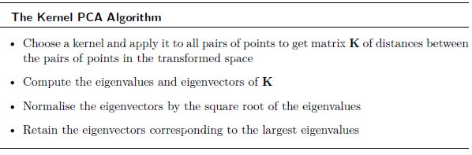
Kernel PCA

Slide 6
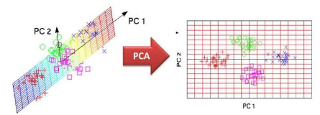
Results

Slide 7
When to use linear or non-linear data model?
Use Linear and non-Linear data model under following conditions:
1. If accuracy is more important to you than the training time then use Non-linear else use Linear classifier.
This is because linear classifier uses linear kernels and are faster than non-linear kernels used in the non-linear classifier.
2. Linear models like SVM is used when number of features are very high, e.g., document classification.
This is because Linear SVM gives almost similar accuracy as non linear SVM but Linear SVM computes faster in such cases.
3. Use non-linear classifier when data is not linearly separable. Under such conditions, linear classifiers give very poor results (accuracy) and non-linear gives better results.
This is because non-linear Kernels map (transform) the input data (Input Space) to higher dimensional space( called Feature Space) where a linear hyperplane can be easily found.

Slide 8
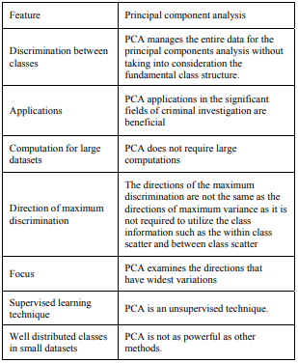
The major features of PCA

Slide 9
Pros ……….
Removes Correlated Features
Lack of redundancy of data given the orthogonal components
Improves Algorithm Performance
By reducing dimensions
Reduces Overfitting
Improves Visualization
Mapping data to principal axis

Slide 10
Cons ………
Independent variables become less interpretable:
After implementing PCA on the dataset, your original features will turn into Principal Components.
Principal Components are the linear combination of your original features.
Principal Components are not as readable and interpretable as original features.
Data standardization is must before PCA:
You must standardize your data before implementing PCA, otherwise PCA will not be able to find the optimal Principal Components.
PCA is affected by scale
Information Loss
The covariance matrix is difficult to be evaluated in an accurate manner
Even the simplest invariance could not be captured by the PCA unless the training data explicitly provides this information

Slide 11
How many features to keep versus how many to drop?
Method 1: We arbitrarily select how many dimensions we want to keep
Method 2: Calculate the proportion of variance for each feature, pick a threshold, and add features until you hit that threshold.
For example, if you want to explain 80% of the total variability possibly explained by your model, add features with the largest explained proportion of variance until your proportion of variance explained hits or exceeds 80%
Method 3: This is closely related to Method 2. Calculate the proportion of variance explained for each feature, sort features by proportion of variance

Slide 12
When should I use PCA?
Do you want to reduce the number of variables, but aren’t able to identify variables to completely remove from consideration?
Do you want to ensure your variables are independent of one another?
Are you comfortable making your independent variables less interpretable?

Slide 13
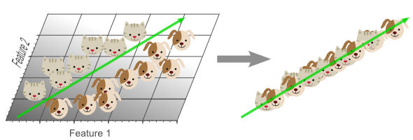
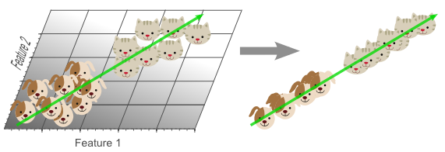
Not to use PCA…..
if all the components of PCA have quite a high variance, there is no 'good' universal stopping rule that allows you to discard some exact 'k' Principal Components, with a guarantee that there will be no 'significant' ( for your application) loss of data in the compression.
Secondly, it is not suitable for some classification problem. Suppose there are 2 classes of your data, but the within class variance is very high as compared to between class variance, PCA might result in you discarding the very information that separates your two classes.
domain knowledge is very important while choosing whether to go forward with PCA or not.
you must check what you have after you used the transformation

Slide 14
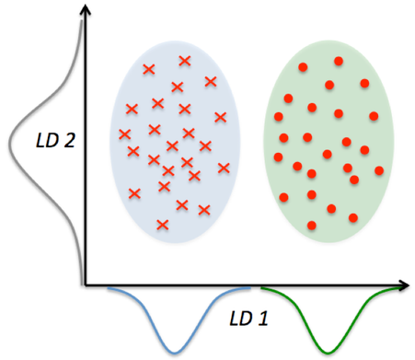
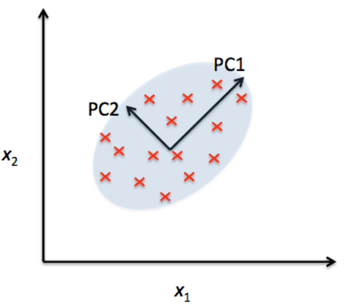
PCA vs LDA
LDA is a supervised whereas PCA is unsupervised – PCA ignores class labels
PCA as a technique that finds the directions of maximal variance
LDA attempts to find a feature subspace that maximizes class separability (note that LD 2 would be a very bad linear discriminant in the figure above).
LDA makes assumptions about normally distributed classes and equal class covariences

Slide 15
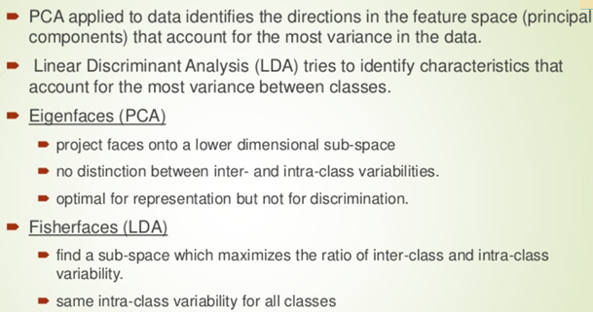
LDA vs PCA

Slide 16
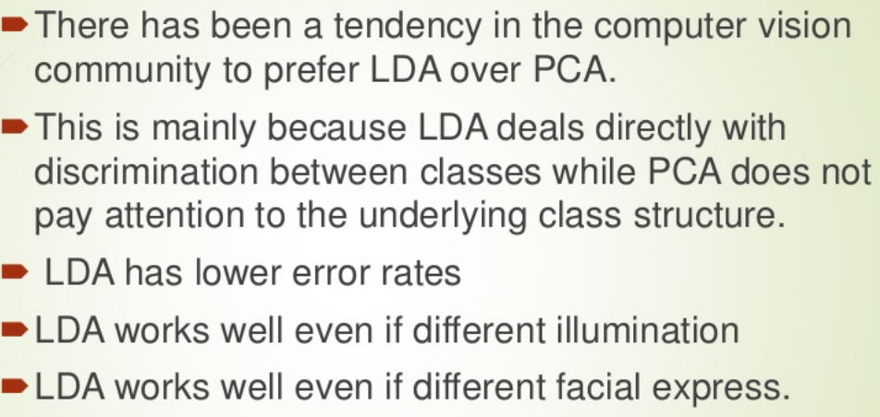
LDA vs PCA

Slide 17
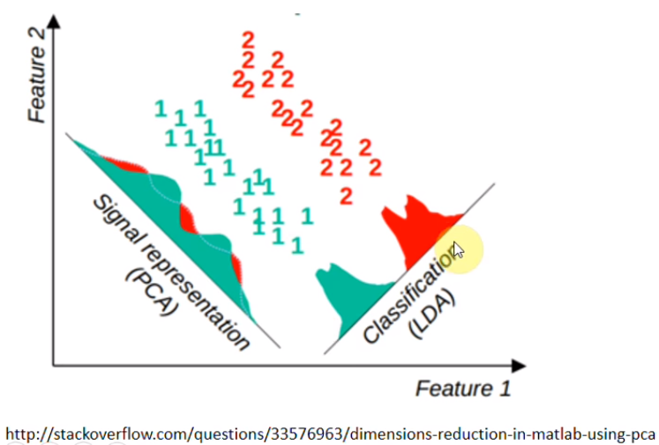
LDA vs PCA

Slide 18
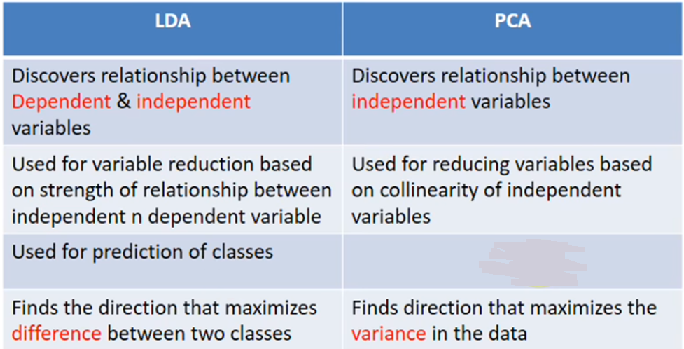
LDA vs PCA

